Slide 1
Employee Data Analysis using Excel
STUDENT NAME: K.SUBBULAKSHMI
REGISTER NO: 312218686
NM ID :autunm169533/COM/22
DEPARTMENT: B.COM GENERAL
COLLEGE : VISHWAKSENAA ARTS & SCIENCE COLLEGE FOR WOMEN

Slide 2
PROJECT TITLE
Employee Performance Analysis using Excel

Slide 3


AGENDA
Problem Statement
Project Overview
End Users
Our Solution and Proposition
Dataset Description
Modelling Approach
Results and Discussion
Conclusion
3/21/2024 Annual Review

Slide 4

PROBLEM STATEMENT
This analysis is done by the company to know about the count of workers in the respective places and know how much are the total count of workers bases on their ratings in the company.

Slide 5

PROJECT OVERVIEW
This project is analysis of number of workers in the company based on the ratings so that the company would be able to find out the total efficient workers of the company department wise in a company.
.

Slide 6

WHO ARE THE END USERS?
The end users of this data analysis will be the company and the company manager.
This analysis helps to find out the count of workers according to the rating of the employee in the company with number and accurate data.
By this they can analyze the workers rating pattern of the company.

Slide 7

OUR SOLUTION AND ITS VALUE PROPOSITION
Conditional formatting :- missing values
Filter remove
Formula performance for summing up
Pivot table – For easy transformation of large data
Pivot summary
Line graph – Data visualization.

Slide 8
Dataset Description
Employee data – edunet dashboard
Total 26 features from A to Z
3 features were taken
Employee rating – number
Department – name
Employee id – text.

Slide 9

THE "WOW" IN OUR SOLUTION
The 3D animated visualization result makes this a absolute blinder wow factor.
3/21/2024 Annual Review
9

Slide 10
MODELLING
Data collection
Data cleaning
Filtering of data
Selecting the required fields
Converting them into a pivot table
Summarising the data
Getting the results from the data after arrangement
Getting the 3D graph
Doing the data visualization
10

Slide 11
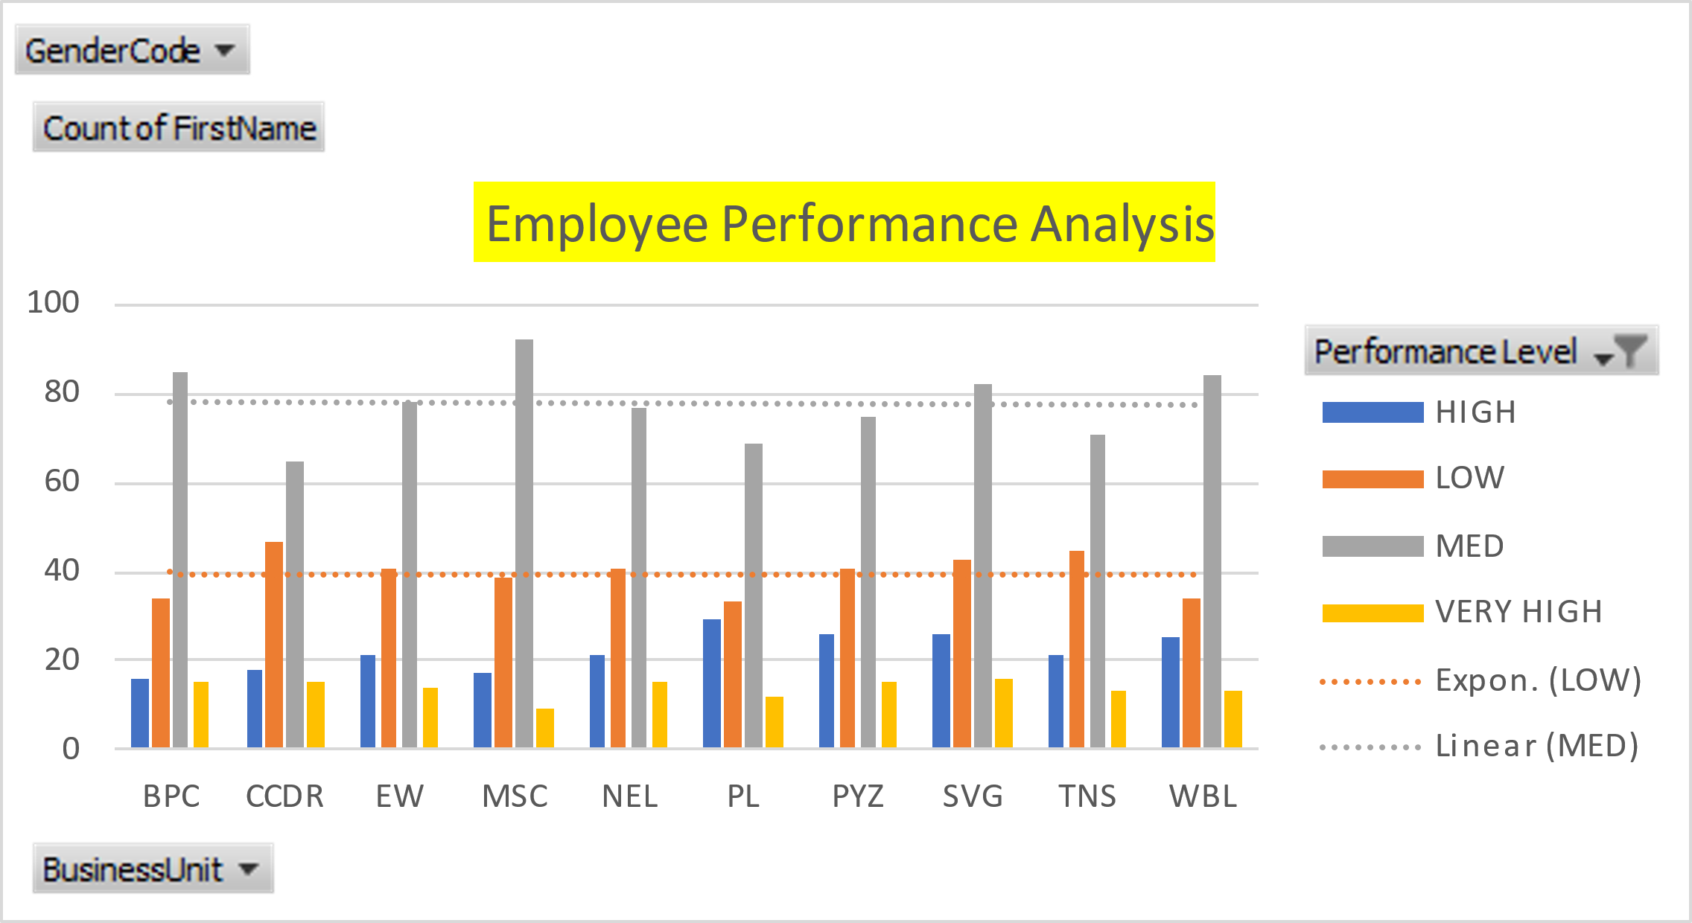
RESULTS
11

Slide 12
conclusion
By this data analysis we can be able to find the number of employees in the company based on their employee rating and the employee id so that the company will be able to find out the efficient worker for the company separately work and extract work from them. So that there will be an boost in the efficiency of the company.

